Slide 1
Behavioral Design Pattern
Instructor: Mehroze Khan

Slide 2
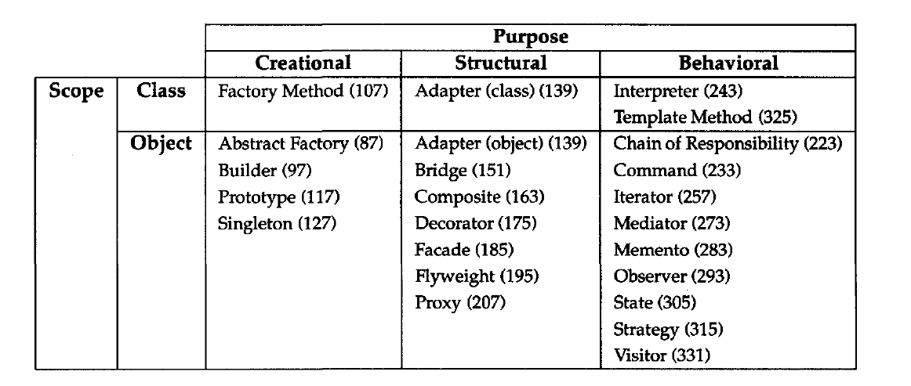
Behavioral Design Pattern
Behavioral design patterns are concerned with algorithms and the assignment of responsibilities between objects.
Behavioral patterns describe not just patterns of objects or classes but also the patterns of communication between them.

Slide 3
Observer Pattern

Slide 4
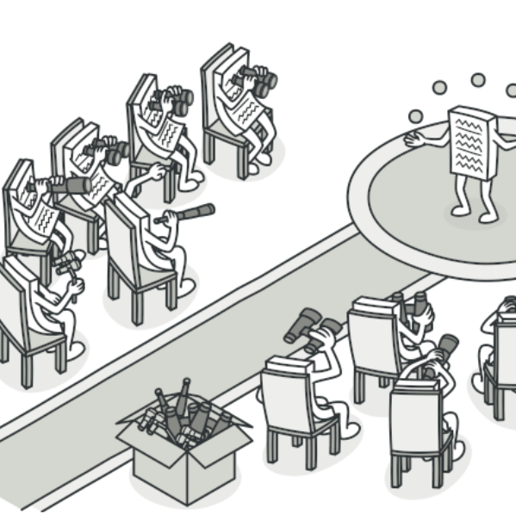
Observer Pattern
Also Known as: Event-Subscriber, Listener
Intent:
Observer is a behavioral design pattern that lets you define a subscription mechanism to notify multiple objects about any events that happen to the object they’re observing.

Slide 5
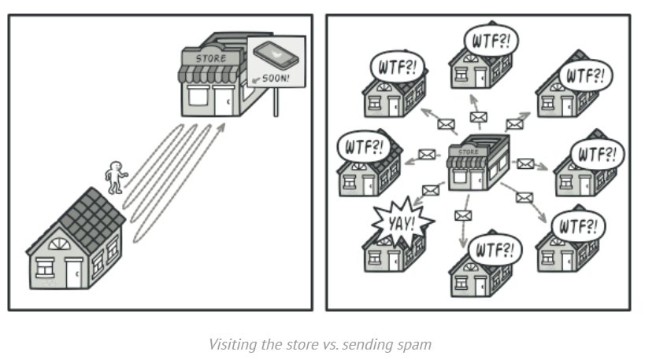
Problem
Imagine that you have two types of objects: a Customer and a Store.
The customer is very interested in a particular brand of product (say, it’s a new model of the iPhone) which should become available in the store very soon.
The customer could visit the store every day and check product availability. But while the product is still enroute, most of these trips would be pointless.

Slide 6
Problem
On the other hand, the store could send tons of emails (which might be considered spam) to all customers each time a new product becomes available.
This would save some customers from endless trips to the store. At the same time, it’d upset other customers who aren’t interested in new products.
It looks like we’ve got a conflict. Either the customer wastes time checking product availability or the store wastes resources notifying the wrong customers.

Slide 7
Solution
The object that has some interesting state is often called subject, but since it’s also going to notify other objects about the changes to its state, we’ll call it publisher.
All other objects that want to track changes to the publisher’s state are called subscribers.

Slide 8
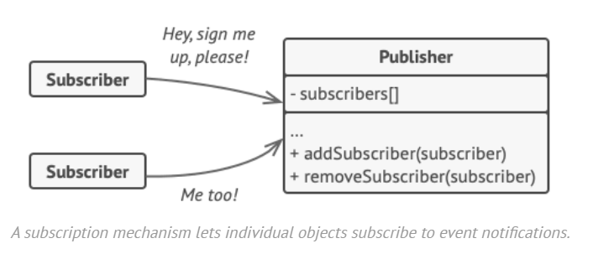
Solution
The Observer pattern suggests that you add a subscription mechanism to the publisher class so individual objects can subscribe to or unsubscribe from a stream of events coming from that publisher.
This mechanism consists of:
1) an array field for storing a list of references to subscriber objects
2) several public methods which allow adding subscribers to and removing them from that list.

Slide 9
Solution
Now, whenever an important event happens to the publisher, it goes over its subscribers and calls the specific notification method on their objects.
Real apps might have dozens of different subscriber classes that are interested in tracking events of the same publisher class.
You wouldn’t want to couple the publisher to all those classes. Besides, you might not even know about some of them beforehand if your publisher class is supposed to be used by other people.

Slide 10
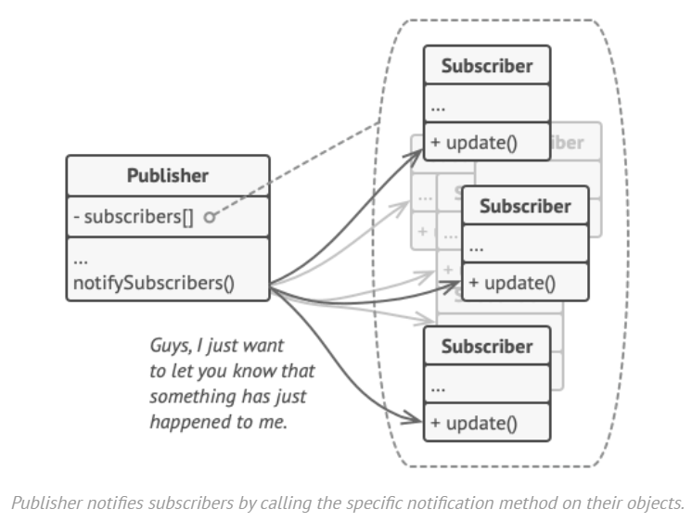
Solution
That’s why it’s crucial that all subscribers implement the same interface and that the publisher communicates with them only via that interface.
This interface should declare the notification method along with a set of parameters that the publisher can use to pass some contextual data along with the notification.
If your app has several different types of publishers and you want to make your subscribers compatible with all of them, you can go even further and make all publishers follow the same interface.
This interface would only need to describe a few subscription methods. The interface would allow subscribers to observe publishers’ states without coupling to their concrete classes.

Slide 11
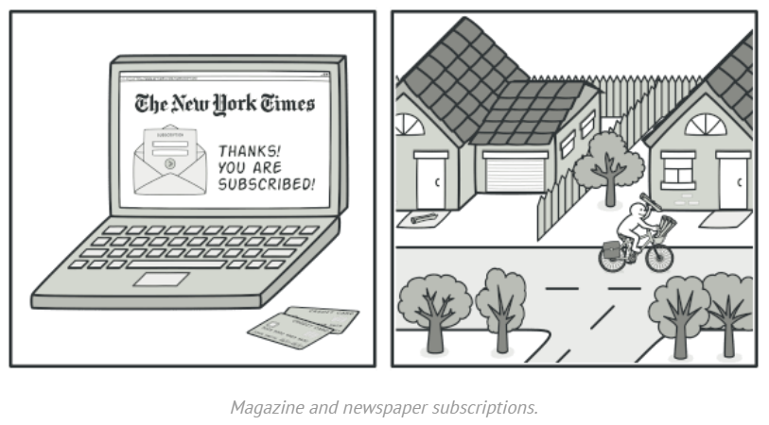
Real World Analogy
If you subscribe to a newspaper or magazine, you no longer need to go to the store to check if the next issue is available. Instead, the publisher sends new issues directly to your mailbox right after publication or even in advance.
The publisher maintains a list of subscribers and knows which magazines they’re interested in. Subscribers can leave the list at any time when they wish to stop the publisher sending new magazine issues to them.

Slide 12
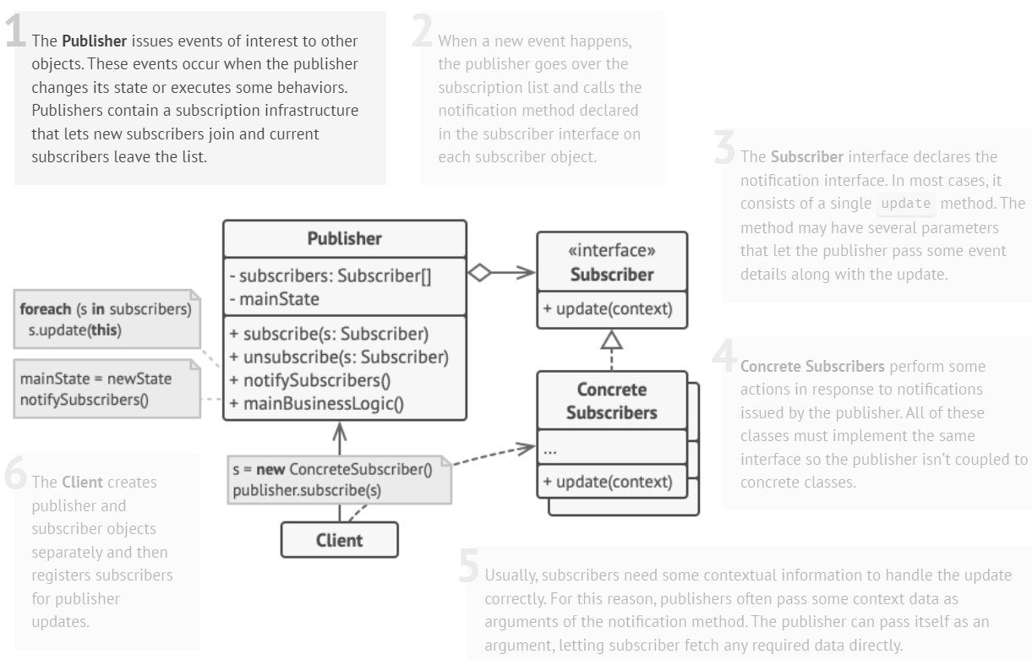
Structure

Slide 13
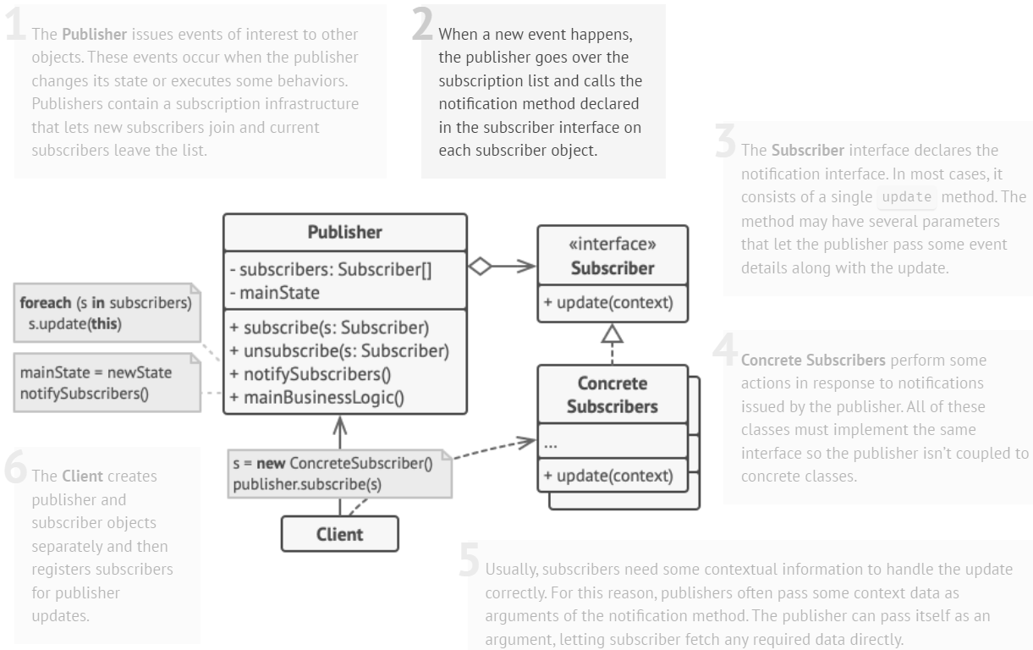
Structure

Slide 14
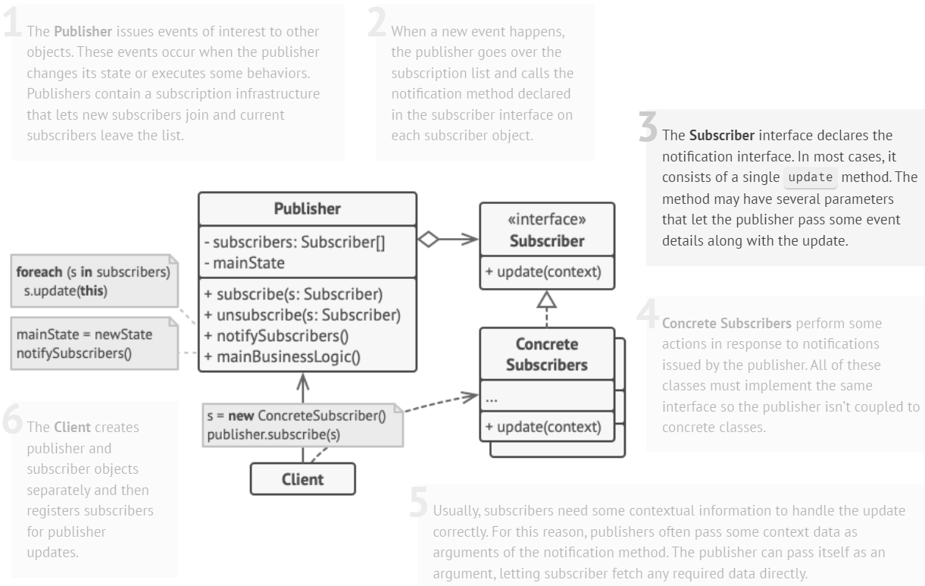
Structure

Slide 15
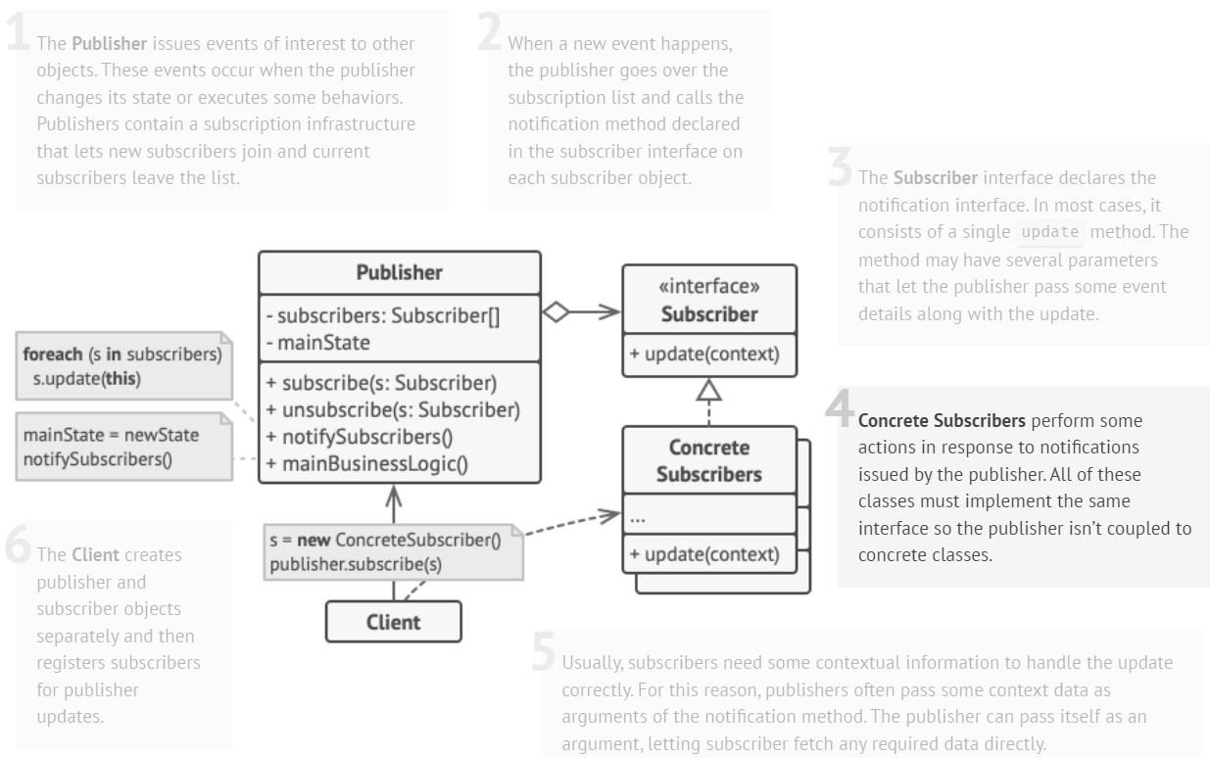
Structure

Slide 16
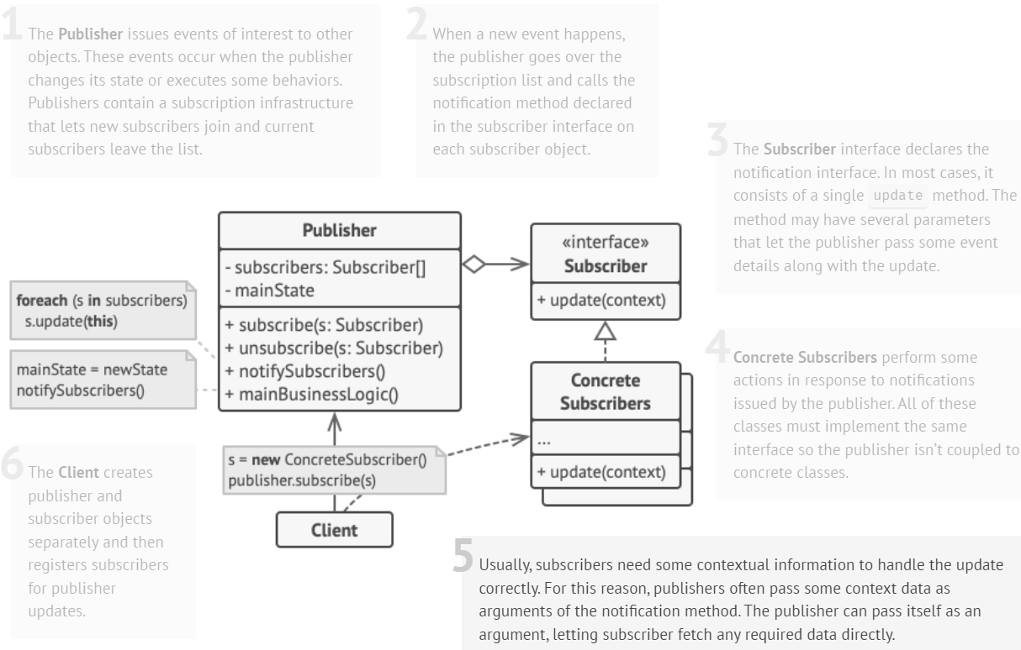
Structure

Slide 17
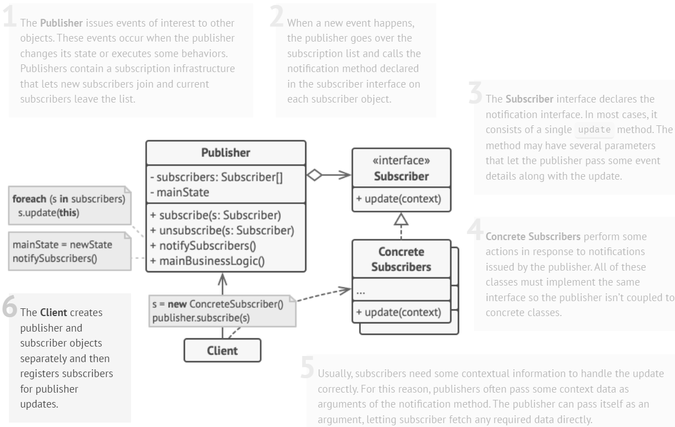
Structure

Slide 18
Example
// Abstract Subscriber class
class Subscriber {
public:
virtual void update(const string& message) = 0;
};
// Concrete Subscriber class
class ConcreteSubscriber : public Subscriber {
public:
void update(const string& message) override {
cout << "Received update: " << message << endl;
}
};
// Publisher class
class Publisher {
private:
list<Subscriber*> subscribers;
public:
void subscribe(Subscriber* subscriber) {
subscribers.push_back(subscriber);
}
void unsubscribe(Subscriber* subscriber) {
subscribers.remove(subscriber);
}
void notifySubscribers(const string& message) {
for (Subscriber* subscriber : subscribers) {
subscriber->update(message);
}
}
};

Slide 19
Example
// Client
int main() {
Publisher publisher;
ConcreteSubscriber subscriber1, subscriber2, subscriber3;
publisher.subscribe(&subscriber1);
publisher.subscribe(&subscriber2);
publisher.subscribe(&subscriber3);
publisher.notifySubscribers("Data updated!");
publisher.unsubscribe(&subscriber1);
publisher.notifySubscribers("Another update!");
return 0;
}
// Output
Received update: Data updated!
Received update: Data updated!
Received update: Data updated!
Received update: Another update!
Received update: Another update!

Slide 20
Pros and Cons
Pros:
Open/Closed Principle
You can introduce new subscriber classes without having to change the publisher’s code (and vice versa if there’s a publisher interface).
You can establish relations between objects at runtime.
Cons:
Subscribers are notified in random order.

Slide 21
References
Design Patterns: Elements of Reusable Object-Oriented Software, Erich Gamma, Richard Helm, Ralph Johnson, and John Vlissides, Pearson, 1995.
Helping Links:
https://refactoring.guru/design-patterns/

